Slide 1
Analyzing teacher’s speech using topics inferred by unsupervised modeling from textbooks
Using textbooks to analyze classroom sessions
03-10-2018

Slide 2
Hello!
I am Catalina Espinoza
I am a research assistant at the Centro de Investigación Avanzada en Educación (CIAE).
Universidad de Chile.
You can reach me at catalina.espinoza@ciae.uchile.cl

Slide 3
Smart Speech Project
Chilean collaborators:
Roberto Araya
Daniela Caballero
Raúl Gormáz
Abelino Jiménez
Catalina Espinoza
Finnish collaborators:
Jouni Viiri
Sami Lehesvuori
Toni Pikkarainen

Slide 4
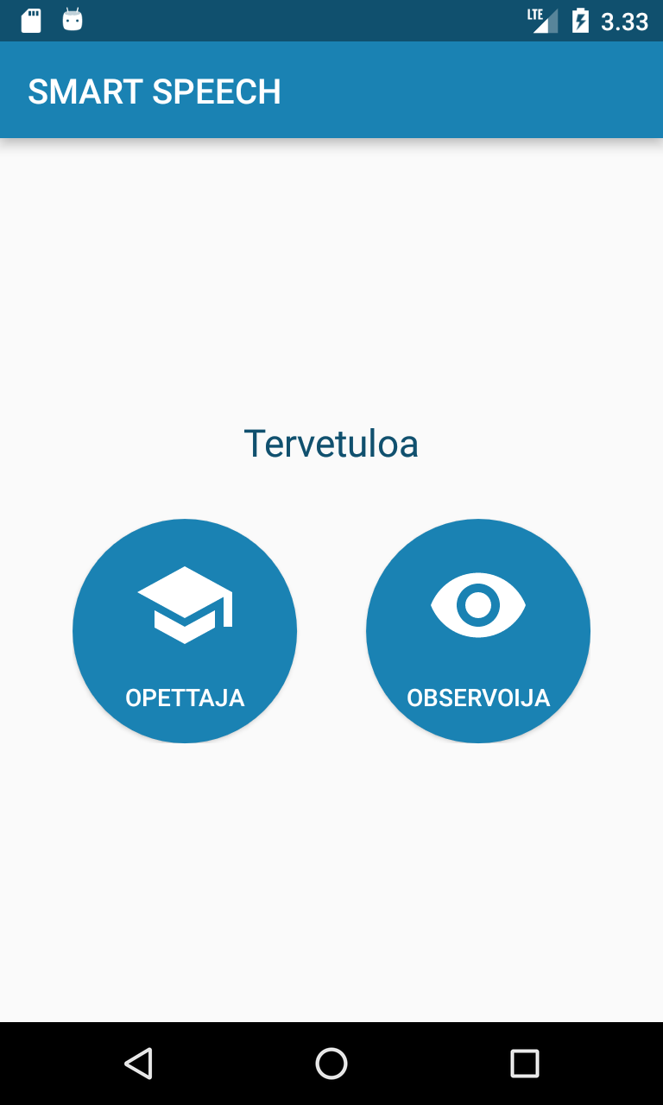
Smart Speech App
Teacher Module
Observer Module

Slide 5
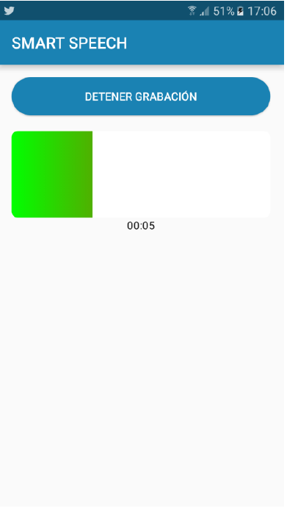
Smart Speech App - Teacher module
The teacher can record the audio of a session, and upload it to the web platform
The audio record is transcribed using an Automatic Speech Recognition service

Slide 6
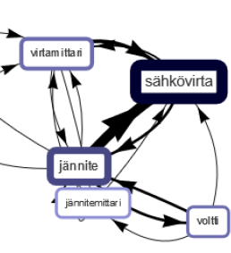
Smart Speech App - Teacher module
Once the transcription is complete, we can visualize the main features of the lesson
The teacher gets feedback of the lesson
Notes:
Here I put a picture of the conceptual network, but it can be any kind of feedback

Slide 7
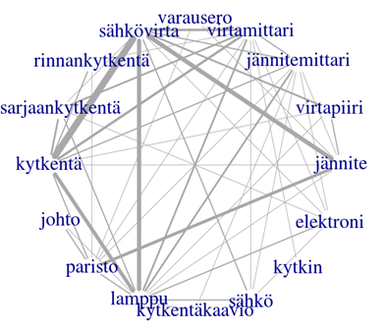
Concept networks visualizations
References
Helaakoski, J., & Viiri, J. (2011). A graph-theoretic perspective on the content structure of physics lessons and its relation to student learning gains. Oppiminen, opetus ja opettajaksi kasvu ainedidaktisen tutkimuksen valossa, 55.
Caballero, D., Araya, R., Kronholm, H., Viiri, J., Mansikkaniemi, A., Lehesvuori, S., ... & Kurimo, M. (2017, September). ASR in classroom today: automatic visualization of conceptual network in science classrooms. In European Conference on Technology Enhanced Learning (pp. 541-544). Springer, Cham.
Notes:
Here I put a picture of the conceptual network, but it can be any kind of feedback

Slide 8
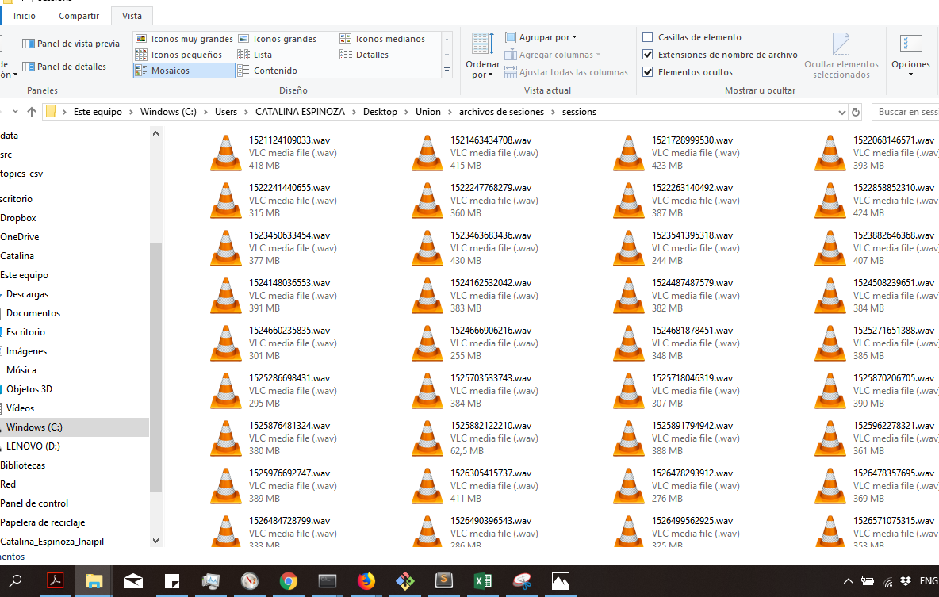
We are gathering transcriptions from classroom sessions
Place your screenshot here
And we are looking for ways to analyze them automatically

Slide 9
From textbooks to lessons
General view of the pipeline

Slide 10
1
Extract text from textbooks pages
2
Preprocess pages
3.
Train unsupervised topic model
5.
Describe lessons using the topic model
4.
Preprocess transcriptions from classroom lessons
THE PIPELINE

Slide 11
Extract text from textbooks pages
We collected 8 school textbooks (content and exercises) in different formats (pdf, word, images)
We extracted the text from each page (~ 2000 pages)
We considered each page as an individual document

Slide 12
2. Preprocess pages
General cleaning
Remove stop words
Detect names
Replace numbers with a tag NUMBER
Remove and replace symbols
Stemming (?)

Slide 13
3. Train unsupervised topic model (LDA)
Latent Dirichlet Allocation (LDA) model (Blei, Ng and Jordan, 2003)
LDA infers topics from a corpus of documents
Topics are groups of words that occur together
Assumptions:
Topics are probability distributions over a dictionary
Documents are bags of words
Documents are described by a mix of topics

Slide 14
30 topics LDA model trained with finnish textbooks
Example of top-10 words from 5 topics
Topic 2
nopeus
aika
matka
kiihtyvyys
kuvaaja
suora
koordinaatistossa
tasaisesti
Ilmanvastus
kerroin
Topic 3
jäsen
lukujonon
kirjoita
suhde
jäsentä
tilavuudesta
riipu
Aritmeettinen
kokoa
tulostaa
Topic 11
painopiste
g
tasapainossa
kappale
tarvitaan
laatikkoa
pysyy
asteista
jarrutusmatka
kappaleen
Topic 13
jännite
pariston
virtapiirissä
sarjaan
sähkövirtaa
kytketään
virtapiirin
virtapiiri
käämin
napojen
Topic 29
valo
valon
valoa
linssin
linssi
kuva
kupera
heijastuu
kuvan
peili

Slide 15
4. Preprocess transcriptions from classrooms sessions
General cleaning
Remove stop words
Detect names
Replace numbers with a tag NUMBER
Remove and replace symbols
Stemming (?)

Slide 16
1.
Extract text from textbooks pages
2.
Preprocess pages
3.
Train LDA Model
5.
Describe lessons using the topic model
4.
Preprocess transcriptions from classroom lessons
THE PIPELINE

Slide 17
Available methods in gensim library (https://radimrehurek.com/gensim/)
get_document_topics(bow, minimum_probability=None, minimum_phi_value=None, per_word_topics=False)
...
LDA MODEL
A text document
(e.g. a phrase, a lesson segment, or the whole lesson)
LDA MODEL
A probability distribution over topics
(a k-dimensional vector)
INPUT
OUTPUT
What can we do with the LDA model?

Slide 18
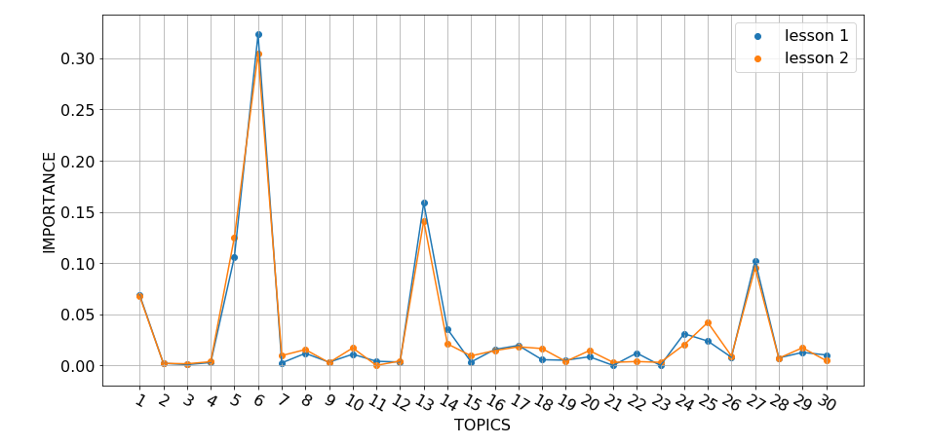
5. Describe sessions using the topic model

Slide 19
Words that activate topics in lesson 1
For topic 6 eli jo esimerkiksi paljon usein hyvin joten vastaavasti
For topic 13 jännite pariston kytketty sarjaan rinnan jännitemittari kaksi Virtapiirissä
virtamittari jännitettä
kytketään virtapiiri napojen paristo kytkentäkaavio sähkövirtaa paristot jännitteen
For Topic 27 tee voit tarkoittaa
For topic 5 lampun eli sähkövirta aika kuinka suuri lamppu

Slide 20
Words that activate topics in lesson 2
For topic 6 eli sähkö enemmän jo paljon hyvin elektroneja vastaavasti jolloin fysiikan lisäksi sisällä
For topic 13 jännite sarjaan rinnan pariston paristo sähkövirtaa kytketään kytketty Virtapiirissä
jännitteen
jännitettä paristot kaksi kytkentäkaavio hehkulamppu
For Topic 27 voit suuntaan tarkoittaa
For topic 5 sähkövirta aika lampun eli suuri lamppu kuinka yksikkö

Slide 21
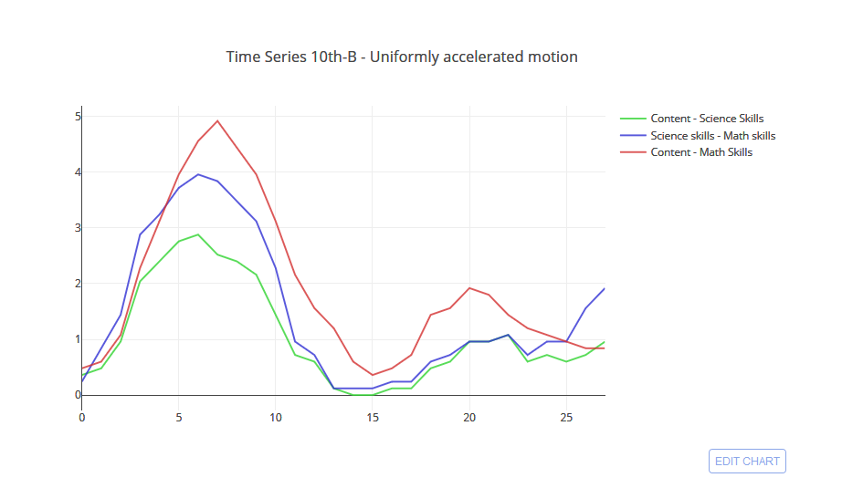
Temporal topic co-occurrence (Chilean lessons)
Co-occurrence strength
Time

Slide 22
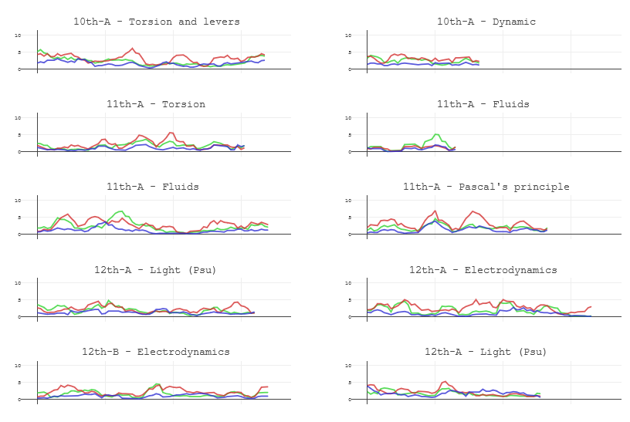
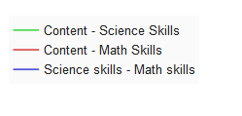
Temporal topic co-occurrence in different sessions
Time
Time

Slide 23
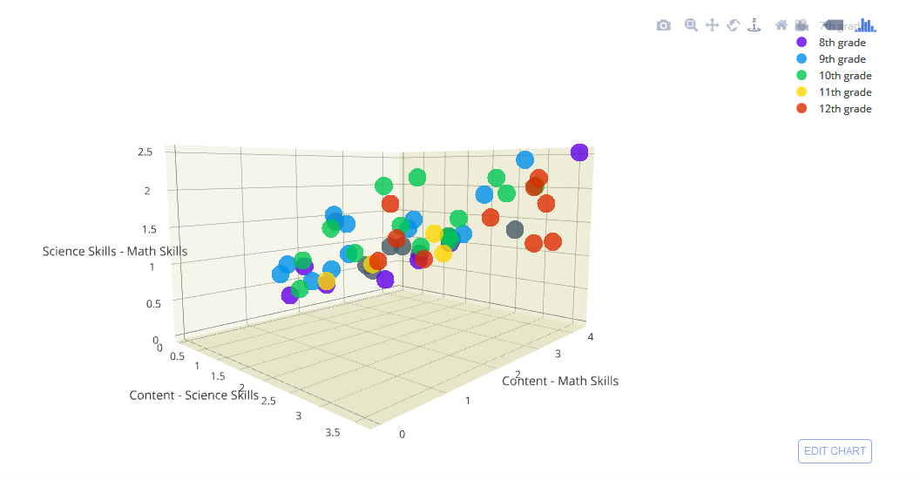
Defining a space to compare different sessions

Slide 24
In summary:
We are describing classroom sessions using topics extracted from textbooks
We want to be able to compare sessions from different content, levels, teachers, and countries.
We are looking for visualizations that are useful to teachers and researchers

Slide 25
Thanks!
Any questions?
You can reach me at:
catalina.espinoza@ciae.uchile.cl

Slide 26
Credits
Special thanks to all the people who made and released these awesome resources for free:
Presentation template by SlidesCarnival
Photographs by Unsplash and myself

Slide 27
Thanks!
Any questions?
You can reach me at:
catalina.espinoza@ciae.uchile.cl

